Slide 1
Unit:2. Making Arrangements
Language focus
-Talk about intentions with be going to
Adverbs of place: outside, inside, there, here, upstairs, downstairs

Slide 2
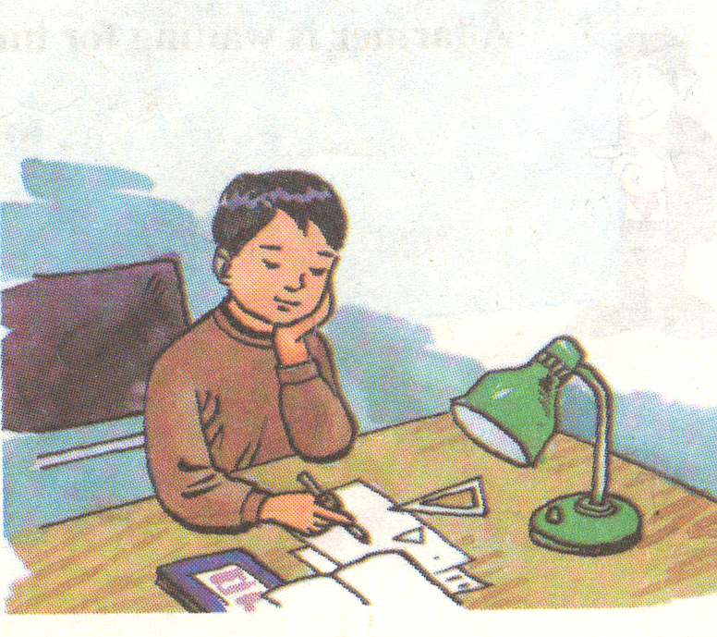
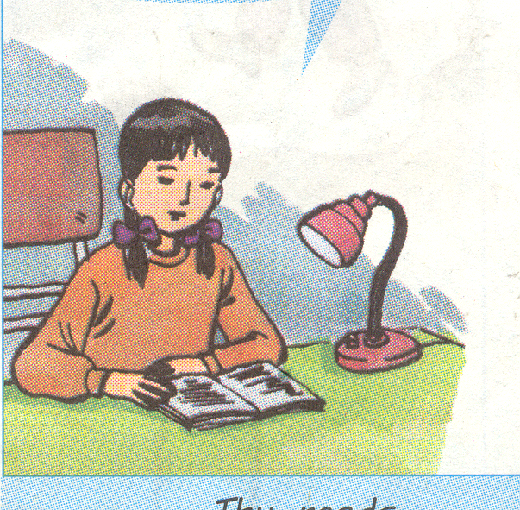
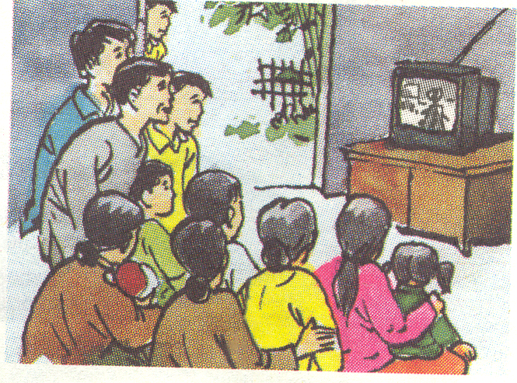
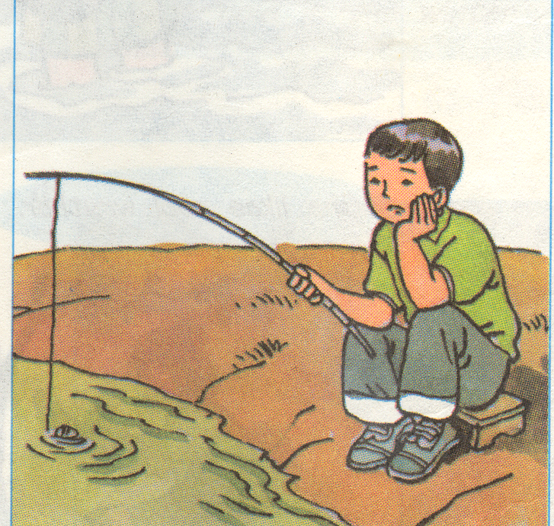
warm up
What are they doing?
1
2
3
4

Slide 3
Nam/ go fishing
=> Nam is going fishing.

Slide 4
Trang/ read a new novel
=>Trang is reading a new novel.

Slide 5
Ba/ do his Math.
=>Ba is doing his Math.

Slide 6
They/ watch TV.
=>They are watching TV

Slide 7
Be going to-V => intension in the future
1. Work with a partner to say what people are going to do.
Ex: Nga has a movie ticket.
=> She is going to see a movie.

Slide 8
a. Quang and Nam bought new fishing rods yesterday.
=>
b. Trang’s mother gave her a new novel this morning and she has no homework today.
=>
c. Van has a lot of homework in Math and she is going to have Math at school tomorrow.
=>
d. Mr. Hoang likes action movies very much and there’s an interesting action movie on TV tonight.
=>
e. Hien’s friend invited her to his birthday party.
=>
They are going (to go) fishing.
She is going to read a new novel.
She is going to do her homework in Math.
He is going to watch an action movie.
She is going to a birthday party.

Slide 9
Complete the table about you.
What are you going to do on the weekend?
Are you going to.......... | You | Your partner
see a movie? | √
play sports? | X
meet your friends?
help your parents?
do your homework?
watch TV?

Slide 10
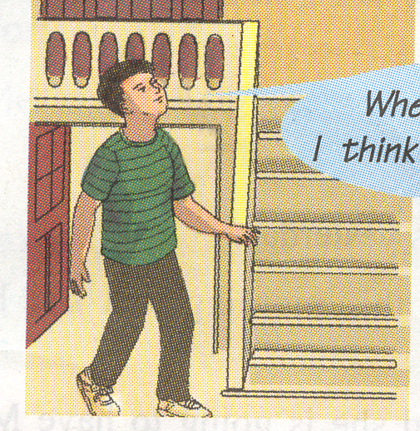
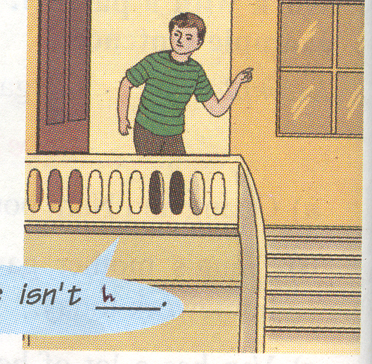
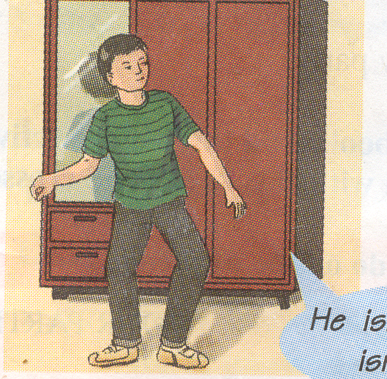
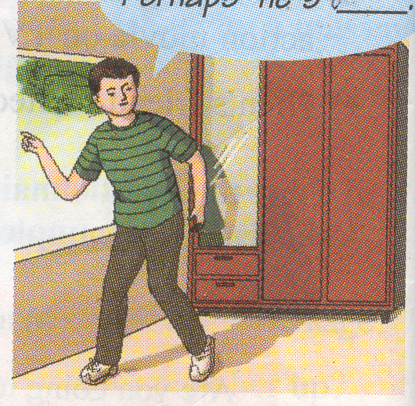
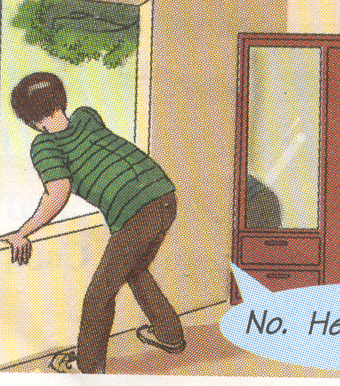
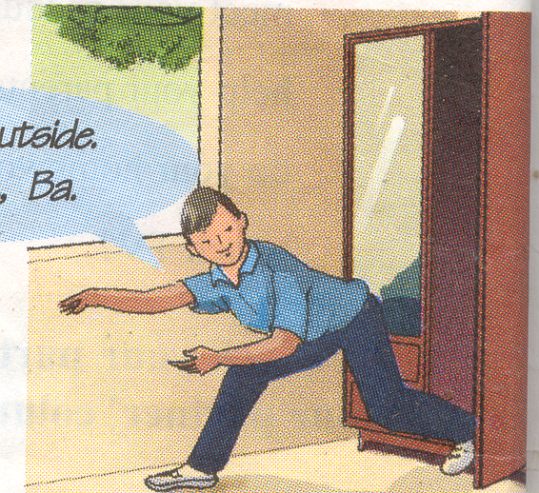
Adverbs of place
outside, inside, there, here, upstairs, downstairs
a
b
c
d
f
e

Slide 11
Complete the speech bubbles.
a.
Where is Tuan?
I think he’s upstairs

Slide 12
b.
No, he isn’t ................
here

Slide 13
c
He isn’t......................
and he isn’t upstairs.
downstairs

Slide 14
Perhaps he’s .............................
d
outside

Slide 15
e
No, he isn’t
.................
there

Slide 16
f
I’m not outside,
I’m........, Ba
inside

Slide 17


HOMEWORK
- Revise the whole unit 2.
- Prepare Unit 3 Getting started + Listen and read.

